Slide 1

Introduction to TSCA Rescue
A 30,000 Foot Overview
Lesson 1A

Slide 2
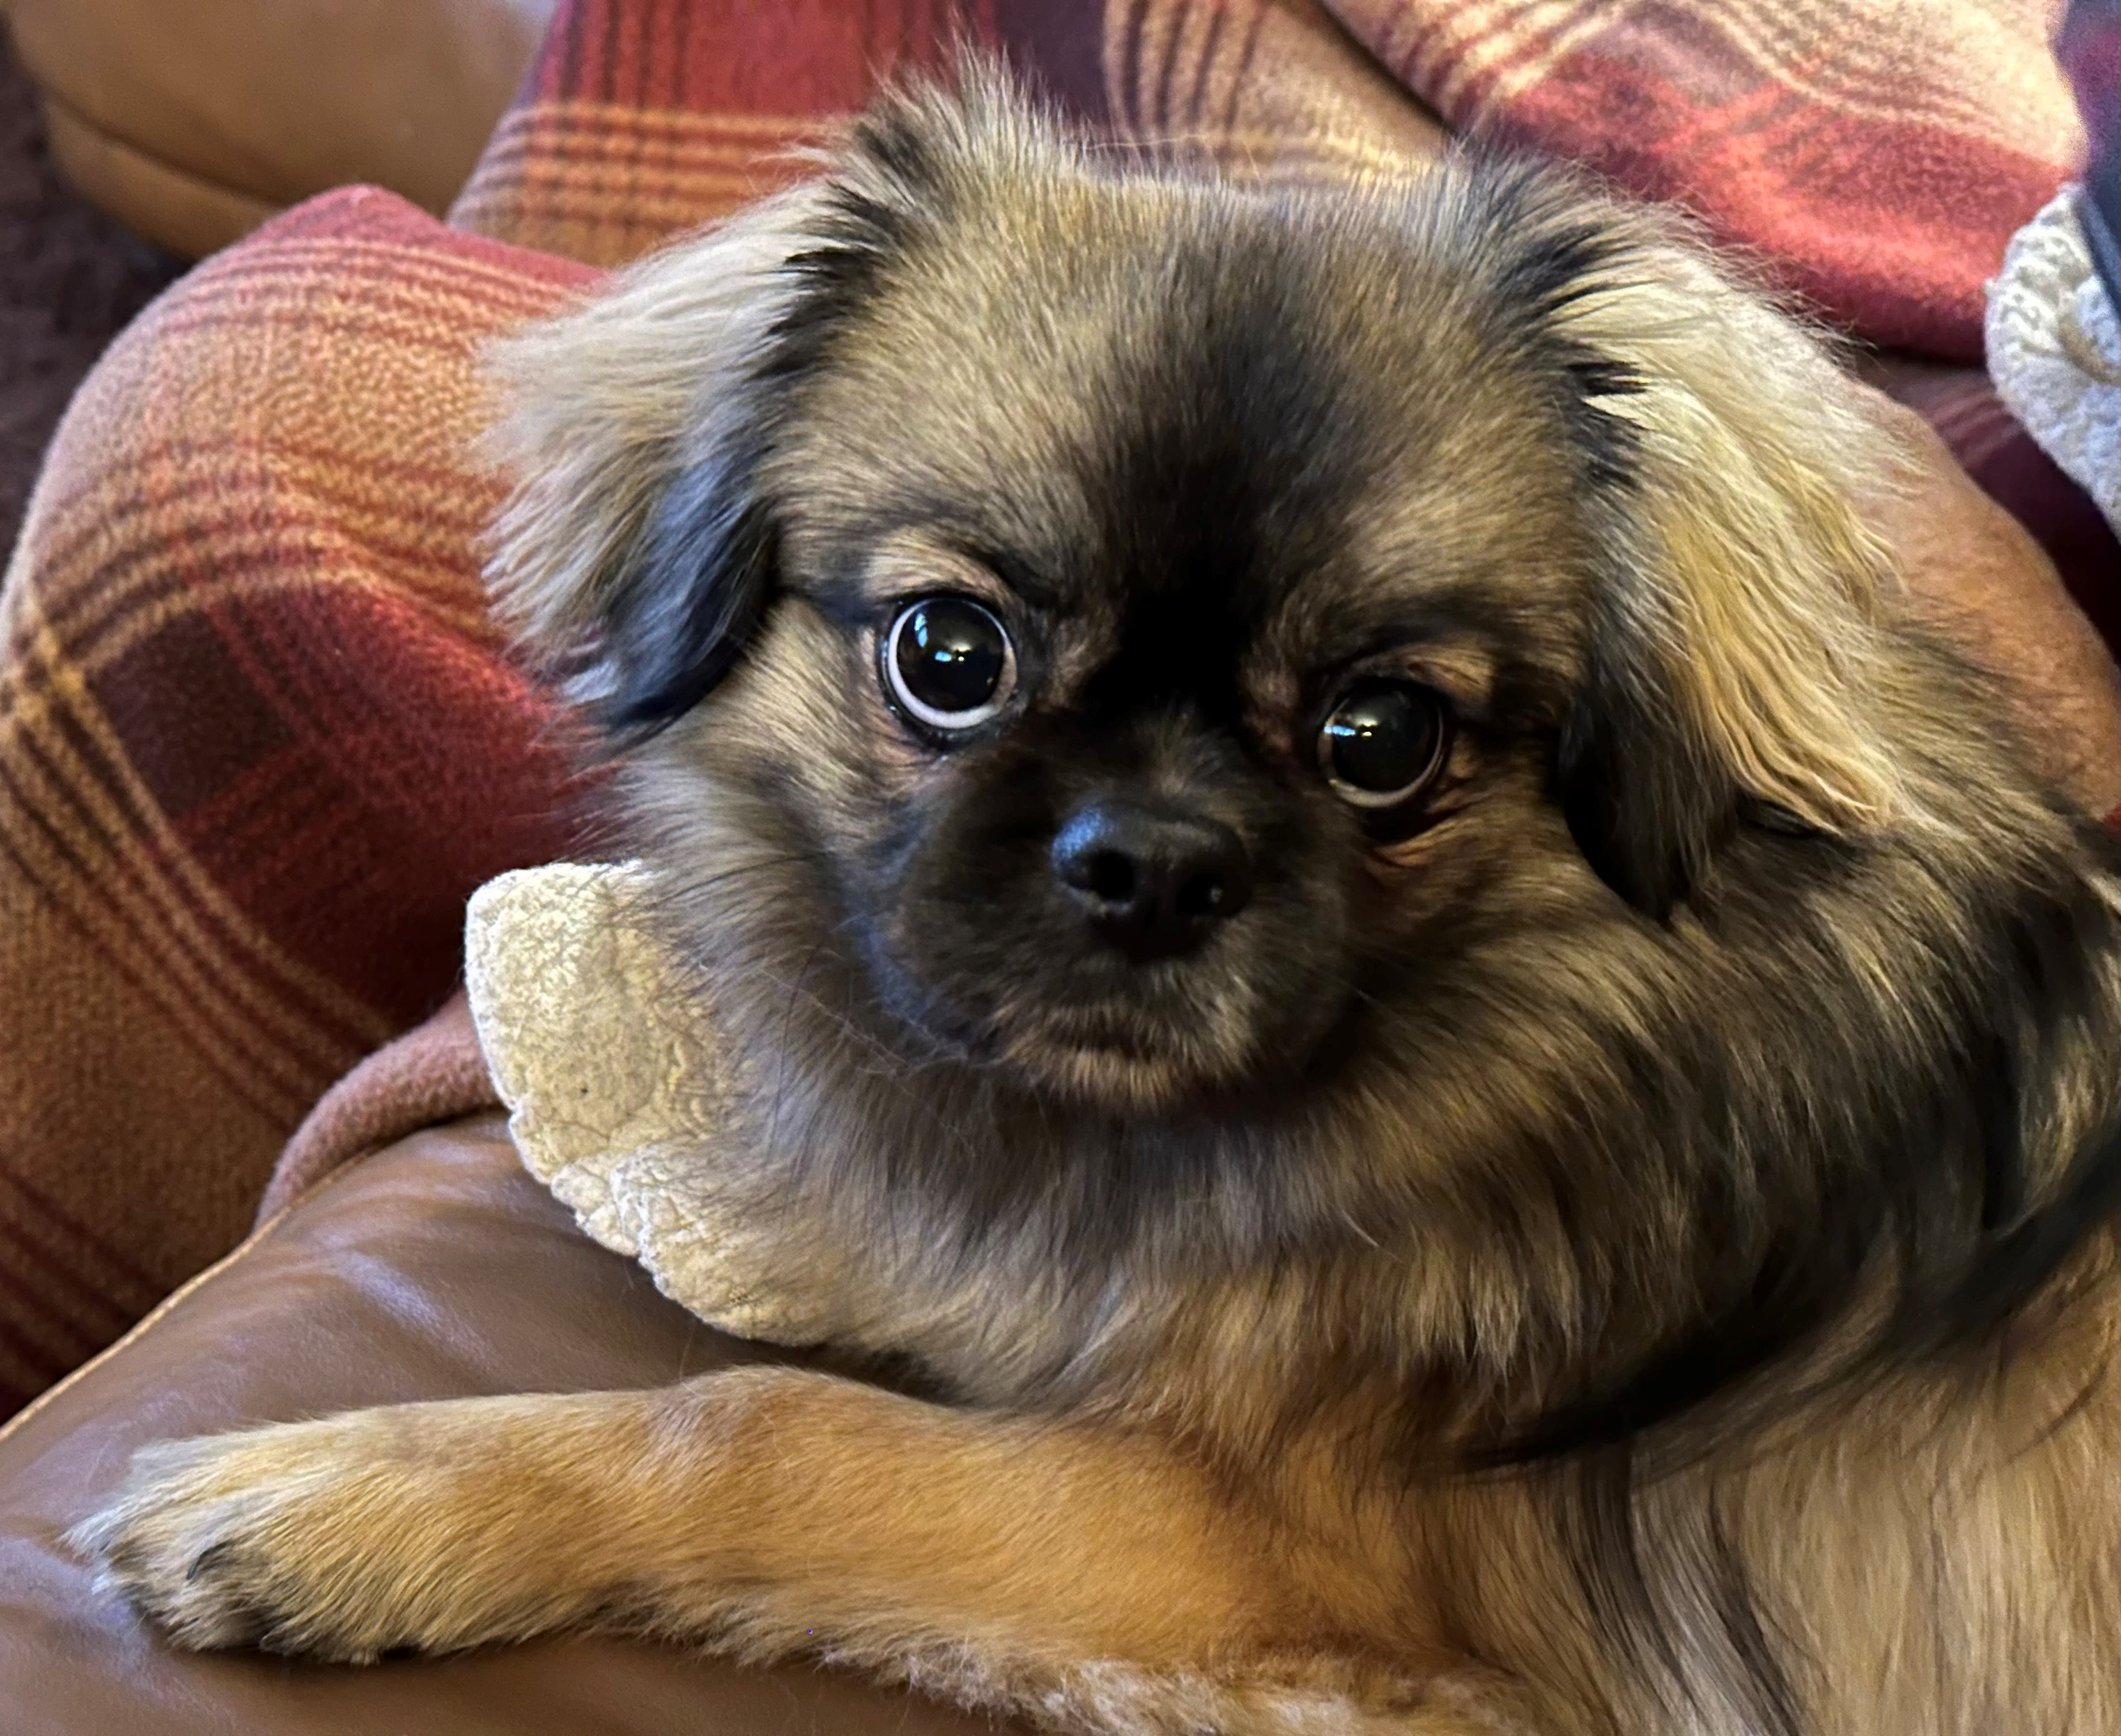
Welcome to the TSCA Rescue Intro Unit!
This Unit is made up of introductory lessons to familiarize you with TSCA Rescue. In this first lesson, we’re going to take you on a high-level flyover – a 30,000 foot overview – of TSCA Rescue to answer these questions for you:
What is TSCA Rescue?
What does TSCA Rescue do?
How is TSCA Rescue organized?
Every topic we introduce in this
lesson will be the subject of its own
lesson later on.
Along the way, you’ll meet some of the precious Tibbies, like Oscar above, whom we’ve helped find their furever homes – just for fun.

Slide 3
What is TSCA Rescue?
In this section, we’ll explain TSCA Rescue and our partner, the TSCA Rescue & Health Trust.

Slide 4
What is TSCA Rescue?
Does this seem like a simple question to you?
Well…it can actually be a bit confusing, but understanding what TSCA Rescue is (and is not) will help you understand why we do some of the things we do. We’ll try to make it easy for you. Let’s break it down…

Slide 5
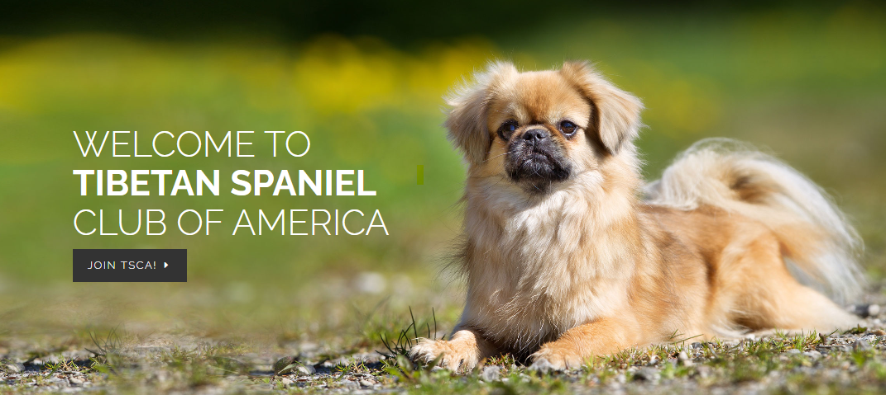
What is TSCA Rescue?
Tibetan Spaniel Club of America (TSCA) Facts:
Recognized by the American Kennel Club (AKC) as the U.S. “parent club” of the Tibetan Spaniel breed
Promotes the education of breeders, fanciers and the general public about the welfare and preservation of Tibbies
Established a Rescue Committee to help Tibbies in need of homes
For more information, see the TSCA Website.
TSCA = Tibetan Spaniel Club of America

Slide 6

What is TSCA Rescue?
TSCA Rescue Facts:
A TSCA committee that reports to the TSCA Board and members
A “breed rescue,” which means we intake only Tibbies, in contrast to “all-breed rescues,” which intake any breed or mix
Operates U.S.-wide and, occasionally, in Canada
A member of the AKC Rescue Network along with other rescues recognized by their breeds’ parent clubs
TSCA Rescue’s National Coordinator is chair of the Rescue committee.
All-volunteer staff – some TSCA members, some not (more about us later…)
TSCA Rescue is part of TSCA.
This Photo by Unknown Author is licensed under CC BY-SA

Slide 7

What is TSCA Rescue?
TSCA Rescue & Health Trust Facts:
The Trust funds TSCA Rescue’s rescue activities.
The Trust is a separate organization from TSCA Rescue. Unlike TSCA Rescue, the Trust is not part of TSCA, but we are partners in rescuing Tibbies.
The Trust is a private, non-profit organization (charity), also called a “501 c 3.” That means that the IRS allows the Trust to take in donations and exempts it from paying taxes on them.
The Trust gets donations from TSCA members and the general public and does fund-raisers such as an annual auction at the TSCA National Specialty.
TSCA Rescue and its volunteers are the “boots on the ground,” while the Trust pays our bills. Because the Trust pays the bills, the trustees play a role in some of our processes. More on that later…
The TSCA Rescue & Health Trust pays TSCA Rescue’s bills.

Slide 8
What is TSCA Rescue?
TSCA Rescue
TSCA Rescue & Health Trust
Part of TSCA, reporting to TSCA Board and membership
Made up of volunteers – some TSCA members, some not
“Boots on the ground” – the hands-on of rescue
Not responsible for fund-raising
Wholly dedicated to rescue
Separate 501 c 3 (private, non-profit) organization from TSCA
Made up of three trustees
Pays bills for TSCA Rescue’s rescue activities
Responsible for fund-raising
Also has a health-related function
Compare TSCA Rescue to TSCA Rescue & Health Trust.

Slide 9

What is TSCA Rescue?
Although TSCA Rescue and the Trust are actually two separate entities, our mission is the same:
Take care of Tibbies in need.
To that end, we partner in the following ways:
Our “public face” is blended – we maintain the same website, same Facebook page, same contact point. (Otherwise, it would be too confusing for the general public.)
We inform the Trust of potential intakes and ask for approval of estimated expenditures.
We update the Trust on the status of rescues in progress.
We coordinate adoption agreements and adopter donations with the Trust.
We coordinate bill paying and reimbursement of rescue expenses with the Trust.
Our partnership with the Trust is based on love of Tibbies.

Slide 10
What does TSCA Rescue do?
In this section, we break down TSCA Rescue’s job. We’re still flying at 30,000 feet – so “how” we do the job will come in later lessons.

Slide 11
What does TSCA Rescue do?
We are a breed rescue. That means we’re allowed to intake only purebred Tibbies. Easier said than done.
When a dog that needs rescuing comes to our attention, it is TSCA Rescue’s job to decide whether the dog is a Tibbie. In turn, that determines whether we ask the Trust for financial support. The Trust must agree with our call before we intake the dog, and the Trust has the final say.
Sometimes rescue Tibbies have AKC “papers,” showing that they are purebred Tibbies. Most of the time, however, there’s no proof of breed, and the breed (or mix of breeds) is someone’s guess. That someone may be a shelter, another rescue, or even the dog’s owner. They may be knowledgeable about Tibbies, or not; the guess may be right or wrong.
Often, shelters and other rescues label Tibbies as another breed (such as a Peke mix), or they label another breed (such as a Peke mix) as a Tibbie. Even the owner may not really know whether a dog is a Tibbie or not a Tibbie.
Tibbie or Not Tibbie? That is the question.

Slide 12
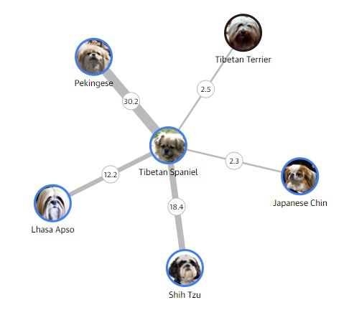
What does TSCA Rescue do?
Tibbies share significant percentages of the DNA that determines “breed” with other small Asian breeds.
Tibbies are closely related to other Asian breeds.
Source: The Guardian based on Canine Genome Project data, 10/2020

Slide 13
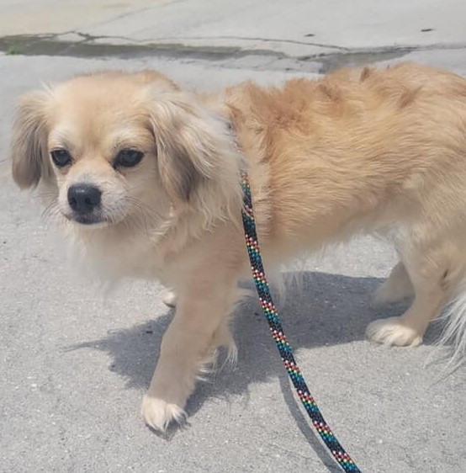
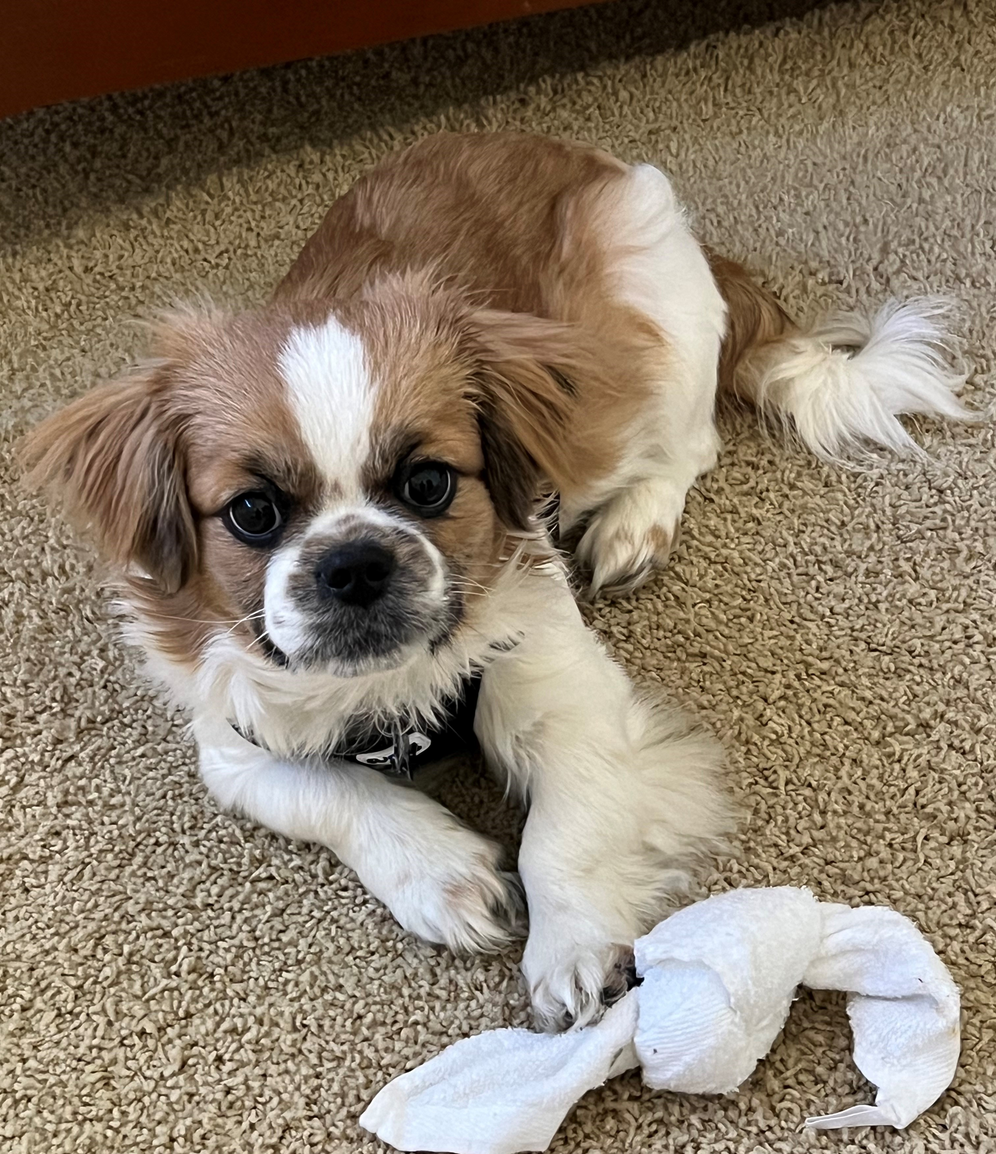
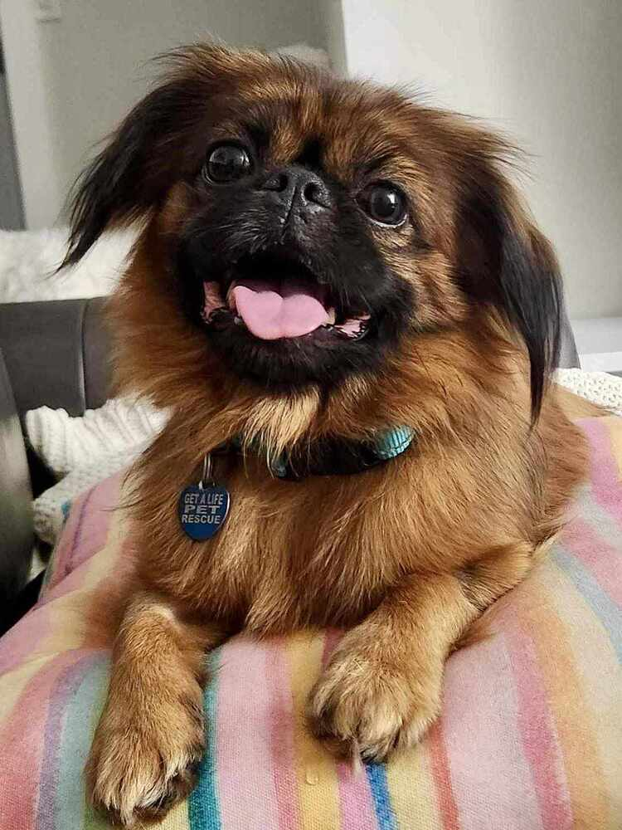
What does TSCA Rescue do?
Since Tibbies are closely related to other Asian breeds, they sometimes closely resemble each other. Which of these adorbs little ones are purebred Tibbies?
Stumped? A lesson on breed identification is available.
Breed identification is the first job.

Slide 14
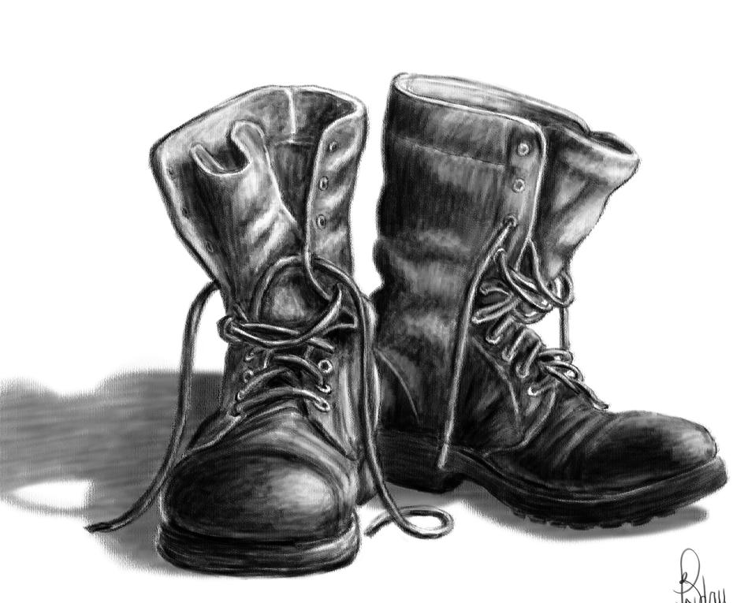
What does TSCA Rescue do?
TSCA Rescue
Maintains a “wait list” of prospective Tibbie adopters in North America
Intakes and fosters Tibbies surrendered or transferred to us
Completes veterinary care for our rescue Tibbies
Selects adopters for Tibbies in our care
Educates fosterers, adopters, and owners about dog care in general and Tibbies specifically
Assists other rescuers that have Tibbies (or possible Tibbies) in their care to reach prospective Tibbie adopters
Maintains website, forms, social media, records, reports and other administrative support for the volunteers wearing the boots
Lessons on all of these roles are under development.
We are the “boots on the ground.”

Slide 15
What does TSCA Rescue do?
The waiting list is our database of prospective adopters. The list currently numbers about 600 hopefuls located in almost all U.S. states, Canada, and Mexico. Many have been waiting for years.
Key points:
We send “Rescue Alert” emails to the waiting list when we have a Tibbie available for adoption and, occasionally, on behalf of another rescue or shelter with a Tibbie in its care.
Most of the Tibbies we intake for re-homing are adopted by people from the waiting list.
To get on the waiting list, people send us an inquiry or file a Prospective Adopter Questionnaire.
People who join the waiting list receive a “welcome email” that explains how TSCA Rescue works. It also includes other sources of Tibbies including TSCA’s breeder referral program and search services such as Adopt a Pet and Petfinder.
TSCA Rescue maintains a waiting list.

Slide 16
What does TSCA Rescue do?
Surrender is the physical transfer of the dog by its owner to a TSCA Rescue volunteer plus formal transfer of ownership to the Trust.
Generally, Tibbies are surrendered because the owner is no longer able to take care of the Tibbie or has died.
Key points:
The surrenderer must own or be authorized to surrender the dog.
Surrendering owners are often heartbroken. Some may be “on the fence.” Sometimes our advice can cause the owner to reconsider surrendering the dog.
The Request to Surrender form captures information that will help us re-home the dog.
We are not allowed to pay for dogs. Nor do we require the surrenderer to make a donation – though we always welcome them!
A lesson on Surrenders is under development.
Most rescue Tibbies are surrenders.

Slide 17
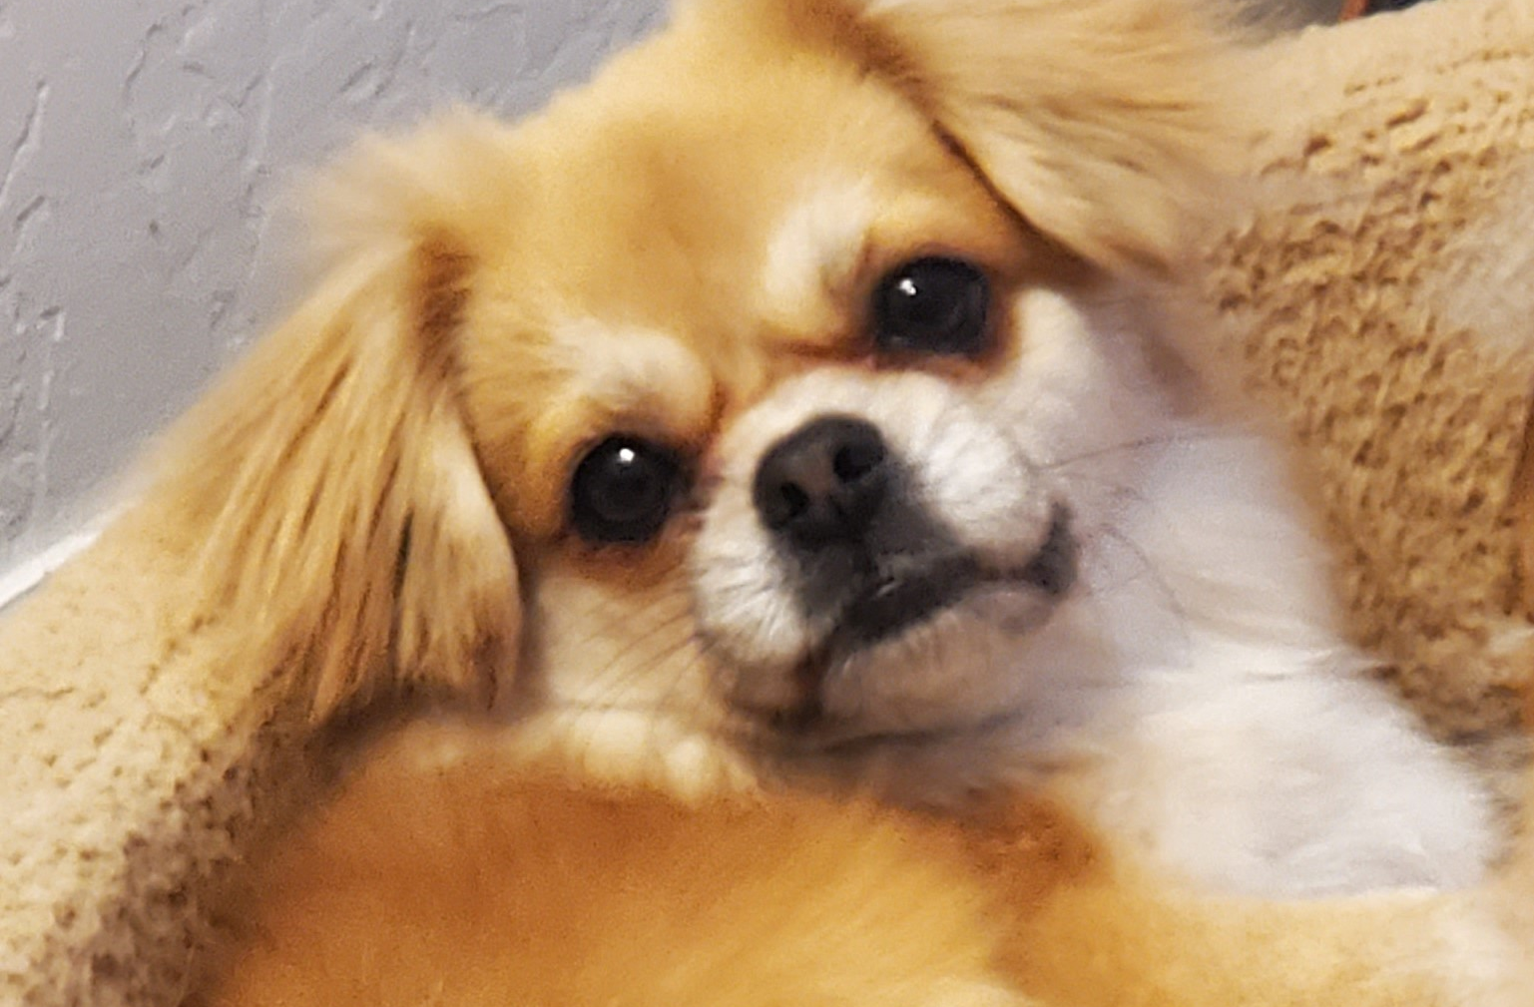
What does TSCA Rescue do?
Ronnie was one of eight Tibbies surrendered together in 2022. Their owner could no longer care for them. We give multiple intakes a name. Ronnie was one of the “California 8.”

Slide 18
What does TSCA Rescue do?
A shelter is a facility that houses animals for adoption. There are two main kinds of shelters in the U.S.:
City or county agency, run by local government, that usually provides an array of animal-related services such as animal control
Private, non-profit (501c3) organization, run by a board, that provides an array of animal-related services, which may or may not include animal control, sometimes under contract to the city or county where they operate
In jurisdictions that have no city- or county-run shelter, private non-profit shelters provide animal-related services. “Humane Societies” often fulfill this role.
Shelters vary in adoption policies, quality of facilities and vet care provided. For example,
Some are “no kill,” while others euthanize after only a few days.
Some readily transfer small dogs to rescues like ours. Others refuse to transfer small dogs to rescues because they are easy to adopt out. Others will transfer only small dogs assessed as “unadoptable” (e.g., due to health or behavior problems).
Some rescue Tibbies come to us from shelters.

Slide 19
What does TSCA Rescue do?
A shelter transfer is when the shelter releases a dog to a private, non-profit rescue like us. We call a transfer “pulling” a dog.
Key points:
When we find out about a purebred Tibbie in a shelter, we generally try to get the shelter to transfer it to us.
Shelters generally require rescues to provide non-profit credentials or to become a “partner” before they approve a transfer.
We rarely get any background on a Tibbie in a shelter. They may have been strays, owner surrenders, or confiscated due to neglect/abuse.
A lesson on Shelter Transfers is under development.
Shelter Transfers

Slide 20
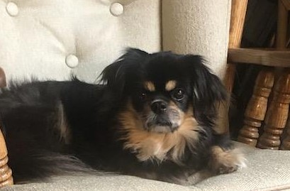
What does TSCA Rescue do?
The “Ojai 3,” Annie and two other Tibbies, were in a private, non-profit Humane Society shelter as the result of a hoarding case. They were transferred to us, and we placed them in happy homes.

Slide 21

What does TSCA Rescue do?
TSCA Rescue is one of hundreds of private, non-profit dog rescues all over the U.S. that do not run shelters. Like us, most are all-volunteer, foster-based operations. Some are all-breed while some, like us, focus on certain breed(s) (e.g., Pekes) and are called breed rescues.
Key points:
Most private, non-profit rescues operate in a limited area. They are known to and maybe official “partners” of the shelters in the area. They “pull” from those shelters as well as taking in surrenders. These rescues can pull a Tibbie from a local shelter before we even find out about it.
When a private, non-profit, non-shelter rescue, like us, has a purebred Tibbie in its care, we do not try to get them to transfer the Tibbie to us. Instead, we try to help them reach people eager to adopt a Tibbie.
When we find a Tibbie in the care of another organization, we have to determine whether it’s a “shelter” or a shelter-less “private, non-profit.” That’s because we pull from shelters; we do not pull from other private, non-profit rescues that, like us, have no shelter. Instead, we do an “assist” for them.
We do not pull from other private, non-profit rescues that, like us, have no shelter.

Slide 22
What does TSCA Rescue do?
An assist is when we help other non-profit rescues, shelters or, occasionally, private owners to connect with prospective adopters.
Key points:
We do assists on dogs that look Tibbie-like as well as those that appear to be purebred. Many prospective adopters don’t care whether or not a Tibbie-like dog is a purebred Tibbie.
Assists benefit not only the dog and the other rescue organization but also people who want to adopt Tibbies or Tibbie-like dogs.
To assist, we post the dog on our Facebook page and, optionally, send a Rescue Alert email to our waiting list.
When the rescue or shelter is unfamiliar with the breed, we send them Tibbie Tips, a flyer to acquaint them with Tibbie traits.
We cannot assist when a private owner is selling the dog. (Donations or fees paid to shelters and private non-profit rescues are not sales.)
A lesson on Assists is under development.
We help Tibbies in the care of other rescues and shelters.

Slide 23
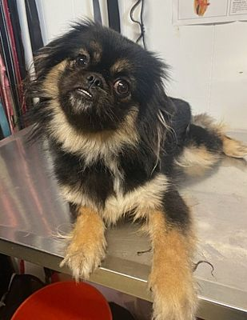
What does TSCA Rescue do?
Abbie was in a county-run shelter. Although we wanted the shelter to transfer her to us, the shelter opted to release her to a local private, non-profit rescue instead. So, we did an assist. A lady on our waiting list adopted Abbie.

Slide 24
What does TSCA Rescue do?
The two kinds of fosterers are temporary foster and foster-to-adopt.
A temporary fosterer is a TSCA Rescue volunteer who takes care of a dog until the veterinary protocol is complete and we have found and approved an adoptive home.
A foster-to-adopt is an applicant we’ve already approved to adopt the dog but who agrees to foster the dog as a TSCA volunteer until the veterinary protocol is complete.
Which kind of foster applies in a given rescue depends on how quickly we need to remove the dog from its current situation.
Temporary = removal of dog is urgent
Foster-to-adopt = dog can safely stay where it is until we select its furever home
Volunteer fosterers are special people who take care of a Tibbie until adopted.

Slide 25
What does TSCA Rescue do?
Both kinds of fosterers provide daily care and shepherd the Tibbie through the veterinary protocol. Their input is invaluable in helping us find the perfect furever home for their foster Tibbie.
Key points:
We screen fosterers just as we do prospective adopters, including a home visit.
Fosterers are responsible for:
Clean, comfortable, safe, indoor housing
Affection, socialization, training, play, and exercise
Grooming (caring for coat and nails, getting rid of parasites)
Fosterers take the Tibbie for needed veterinary care.
Fosterers observe, test, and evaluate the Tibbie’s temperament and behavior, such as energy level, likes/dislikes, and training (house, crate, lead).
A lesson on Fostering is under development.
All fosterers must be TSCA Rescue volunteers who follow coordinator guidance.

Slide 26

What does TSCA Rescue do?
The veterinary protocol is a list of required services that Tibbies we intake must complete before we finalize their adoption. Depending on the Tibbie’s age and any prior veterinary records we can get, the protocol includes, but is not limited to, services such as:
general exam
microchipping
vaccinations
heartworm test
de-worming
spay/neuter
dental cleaning
blood work
A form called the Veterinary Protocol Checklist helps us keep track.
A lesson on the Veterinary Protocol, including estimating expenses for the Trust and selecting a vet, is under development.
Tibbies in our care must complete a veterinary protocol.

Slide 27
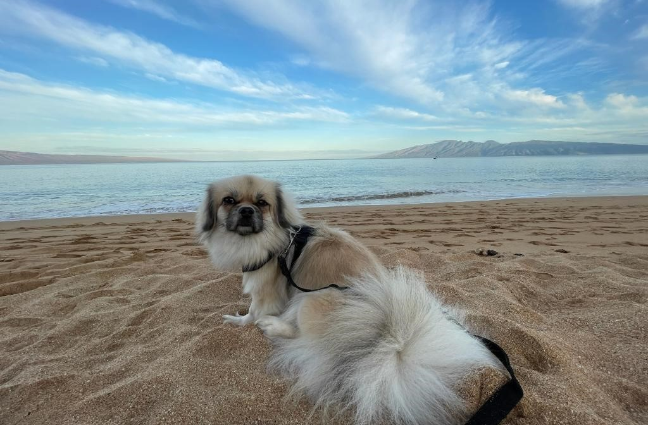
What does TSCA Rescue do?
Lovely Lolha’s former owner surrendered her to TSCA Rescue. For her well-being, we quickly moved her to a temporary foster mom volunteer who took care of her for 3 months. During that period, she completed the veterinary protocol, and we selected her furever home.

Slide 28
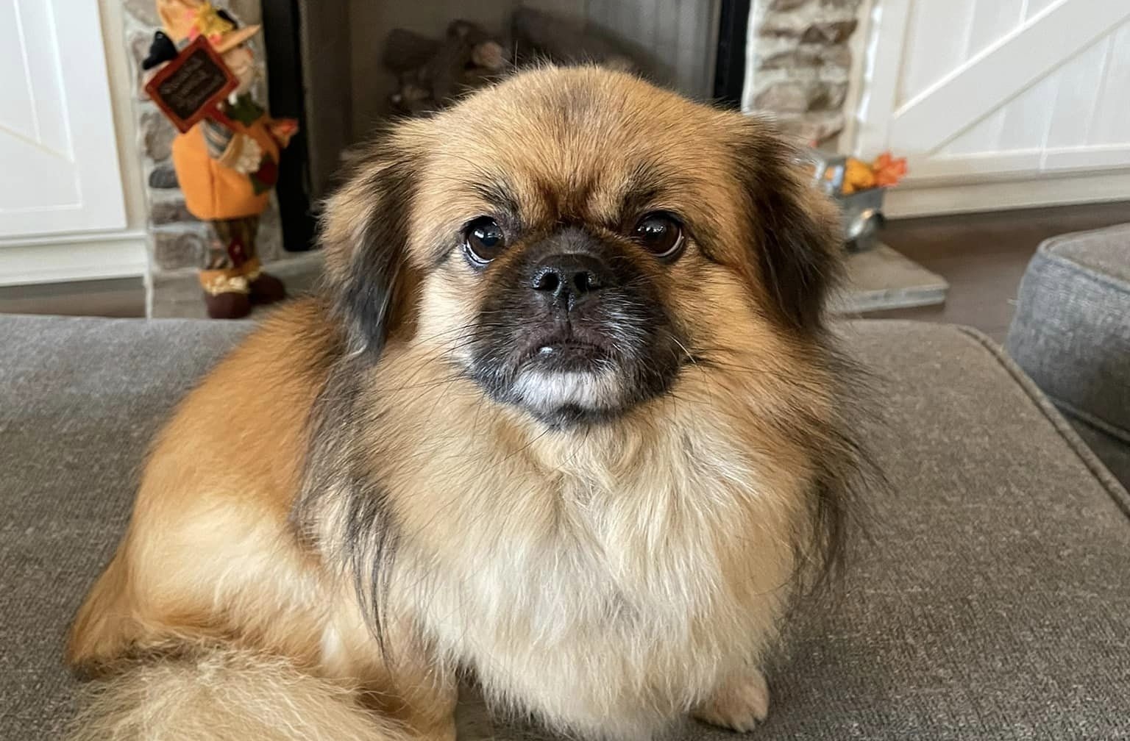
What does TSCA Rescue do?
His owner contacted us to surrender 8-year-old Donut but agreed to keep him until we selected a foster-to-adopt home. After moving in with his foster-to-adopt mom, he remained in “foster status” with TSCA Rescue for 2 months while completing the vet protocol. We then finalized his adoption and transferred his ownership to the foster-to-adopt mom.

Slide 29
How is TSCA Rescue organized?
In this section, we show you the organization of TSCA Rescue and introduce you to our volunteer roles.

Slide 30
How is TSCA Rescue organized?
A brief history…
The TSCA Rescue that exists today started about 2013 with a single coordinator and a few volunteers scattered around the country.
In 2022, a reorganization began and continues until today – it’s a “work in progress” with several ongoing projects and new volunteers in various stages of training.
Many materials are under development, including online forms and training units, to help our volunteers, applicants, and adopters.
Thank you for your patience!
TSCA Rescue is a work-in-progress.

Slide 31

How is TSCA Rescue organized?
Goals of Reorganization
Projects We’re Working On
Improve our ability to help Tibbies and their adopters.
Improve consistency, efficiency, and professionalism nationwide.
Grow our volunteer network.
Act as a team to better allocate work.
Respond quickly to regional situations.
Implement online forms for public use.
Recruit volunteers.
Develop training units.
Improve and update our Handbook, website, and Facebook page.
Implement online resources for volunteers including forms, job aides, etc.

Slide 32
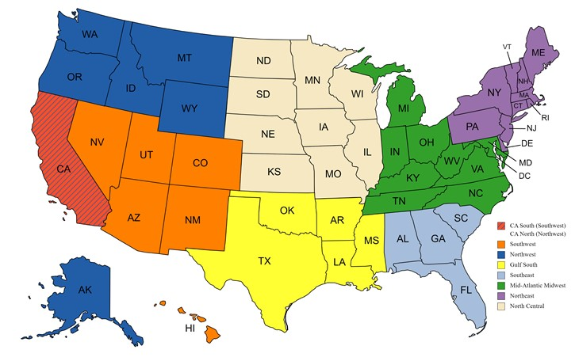
How is TSCA Rescue organized?
TSCA Rescue is now divided into 7 regions, each with its own coordinator(s) and volunteers. California is shared by two regions.

Slide 33

How is TSCA Rescue organized?
This is our “dream team.” We don’t have people in all of these roles yet. Our current volunteers wear more than one hat.
National Coordinator
National Advisor
Volunteer Coordinator
Training Coordinator
IT
Networking
Regional Coordinators
Inquiries Coordinator
Outreach Coordinator
Social Media Volunteers
Foster & Transport Volunteers
Roles in TSCA Rescue
See About TSCA Rescue on our website.

Slide 34
How is TSCA Rescue organized?
The National Coordinator oversees and is responsible for the quality and professionalism of all TSCA Rescue work.
National Coordinator
Consults with and provides guidance to all other coordinators
Reviews written work products produced by coordinators (e.g., web, TSCA Rescue Handbook, Rescue Alerts, training units)
Manages ongoing projects
Liaises with the Trust on all matters that require Trust input (e.g., support requests, status reports, expense estimates, donations)
Liaises with the TSCA Board of Directors and TSCA membership as needed
Writes a quarterly report for publication in TSCA Newsletter
National Coordinator Responsibilities

Slide 35
How is TSCA Rescue organized?
The National Advisor collaborates with the National Coordinator and is an at-large mentor for all coordinators.
National Advisor
Provides advice and resources to coordinators and others, especially on dog behavior and training
Counsels adopters, fosterers and others on Tibbie care and safety
Prepares educational materials
Reviews written work products produced by coordinators (e.g., web, TSCA Rescue Handbook, Rescue Alerts, training units)
National Advisor Responsibilities

Slide 36
How is TSCA Rescue organized?
Regional Coordinators (RCs) manage rescues within their regions. We need 2 Regional Coordinators in most regions.
Regional Coordinators
Follow procedures in the TSCA Rescue Handbook and training units
Arrange intake of Tibbies, both shelter transfers and surrenders
Oversee care of rescue Tibbies in foster homes and ensure the veterinary protocol is completed as economically as possible
Write Rescue Alerts on Tibbies available for adoption
Review adoption applications (Prospective Adopter Questionnaires), screen applicants (e.g., home visits, reference checks), select and notify the adopter, prepare adoption packets and Adoption Agreement
Arrange transport
Maintain records on each Tibbie
Report status to National Coordinator
Pitch in to help other RCs as needed
Regional Coordinator Responsibilities

Slide 37
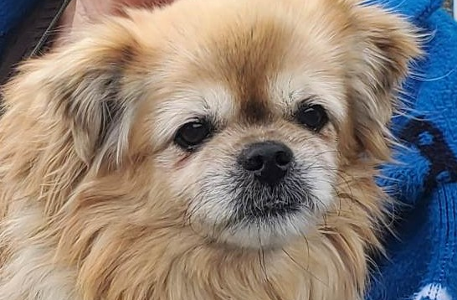
How is TSCA Rescue organized?
Buttercup was surrendered to a California shelter at age 14. The shelter posted her on Adopt a Pet where we spotted her. The Southwest RC arranged her transfer to us. Transporters brought her to her foster mom, and she completed our vet protocol. Meanwhile, the RC selected an adopter, finalized the adoption and arranged transport.

Slide 38
How is TSCA Rescue organized?
The Volunteer and Training Coordinators collaborate to bring volunteer recruits up to speed in their roles.
Volunteer Coordinator
Recruits volunteers and maintains volunteer rosters
Screens and orients incoming coordinators and other volunteers
Training Coordinator
Identifies training needs
Develops and delivers training units
Develops and maintains resources for coordinators including job aides and the TSCA Rescue Handbook
Tracks required training completed
Support Roles:
Volunteer Coordinator
Training Coordinator

Slide 39
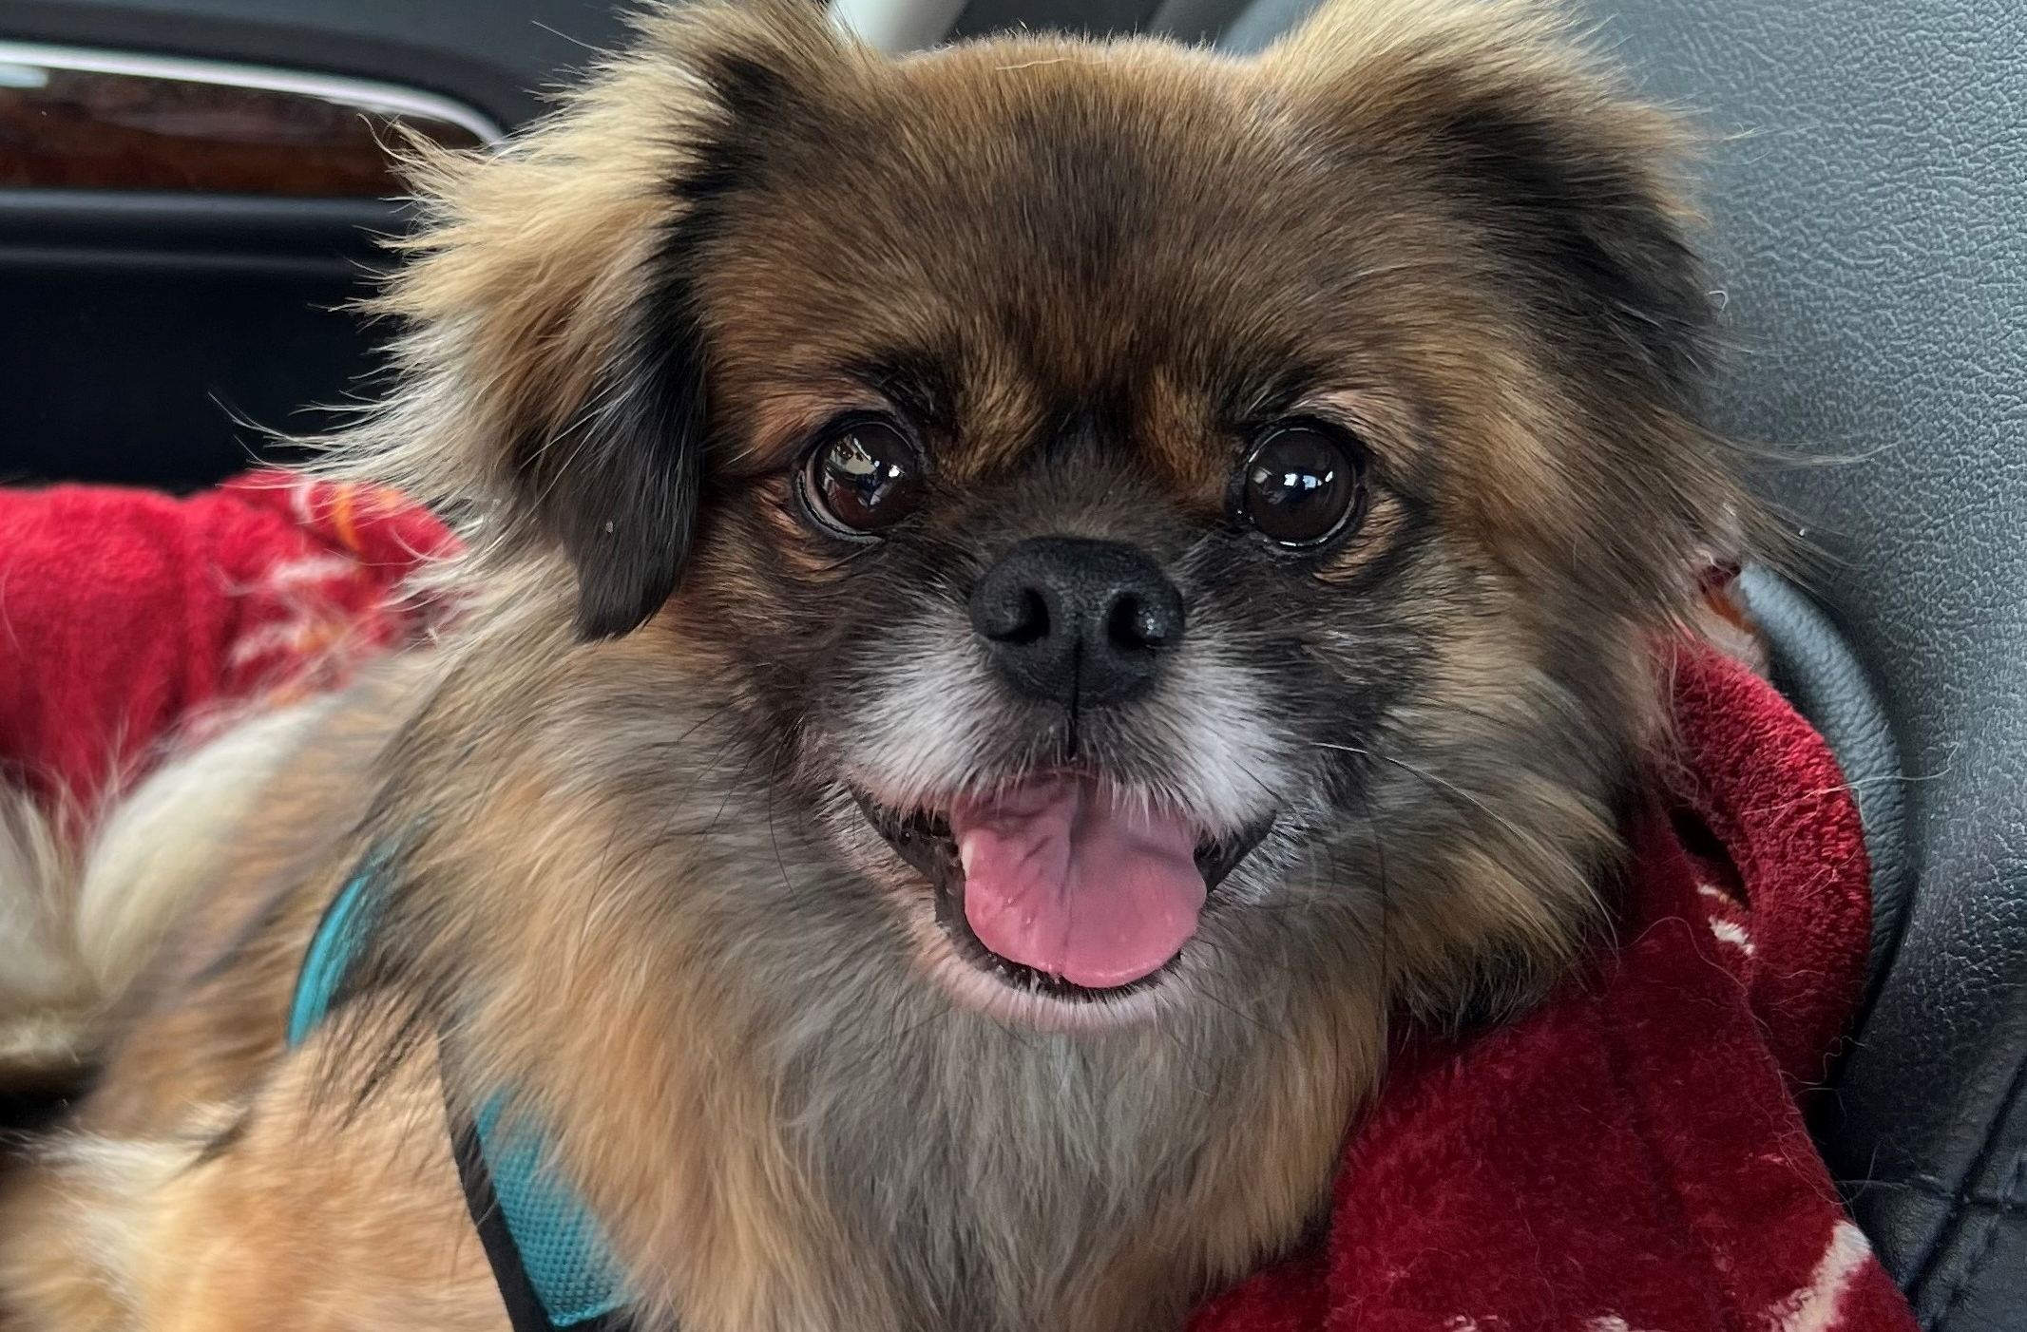
How is TSCA Rescue organized?
Timmy, age 4, was surrendered as one of the California 8. He is a “special needs” Tibbie who has cerebellar hypoplasia, a neurologic disease that causes movement, balance, and coordination problems. His adopter, who is experienced with neurologically impaired dogs, joined the waiting list 2 days after we released his Rescue Alert. She saw the Alert and applied for Timmy immediately. Two weeks later, he was in his furever home.

Slide 40
How is TSCA Rescue organized?
The Inquiries and Outreach Coordinators work together and with the IT Coordinator to keep our “back office” processes moving along.
Inquiries Coordinator
Answers inquiries from prospective adopters (e.g., welcome email)
Maintains prospective adopter waiting list and distribution lists
Distributes Rescue Alert emails that RCs prepare to the waiting list
Outreach Coordinator
Writes the rescue-related content for the TSCA and Trust’s websites.
Writes and posts social media content, including assists
Creates “publicity” as needed (e.g., flyers, Specialty presentations)
Reviews content written by coordinators
Initiates outreach to and maintains contact with key shelters, other rescues and veterinary practices for educational purposes
Support Roles:
Inquiries Coordinator
Outreach Coordinator

Slide 41

How is TSCA Rescue organized?
The IT Coordinator works with all the other coordinators to support all of our processes.
IT Coordinator
Posts website and social media content (written by others) and photos
Liaises with the webmaster (BizMarquee) as needed
Facilitates resource sharing and networking using apps such as Google Drive and Zoom
Collaborates to create and maintain online forms for public and internal use, such as the Prospective Adopter Questionnaire and Home Visit Checklist
Routes and stores incoming online forms
Helps other volunteers with software as needed
Support Role: Info Tech (IT) Coordinator

Slide 42
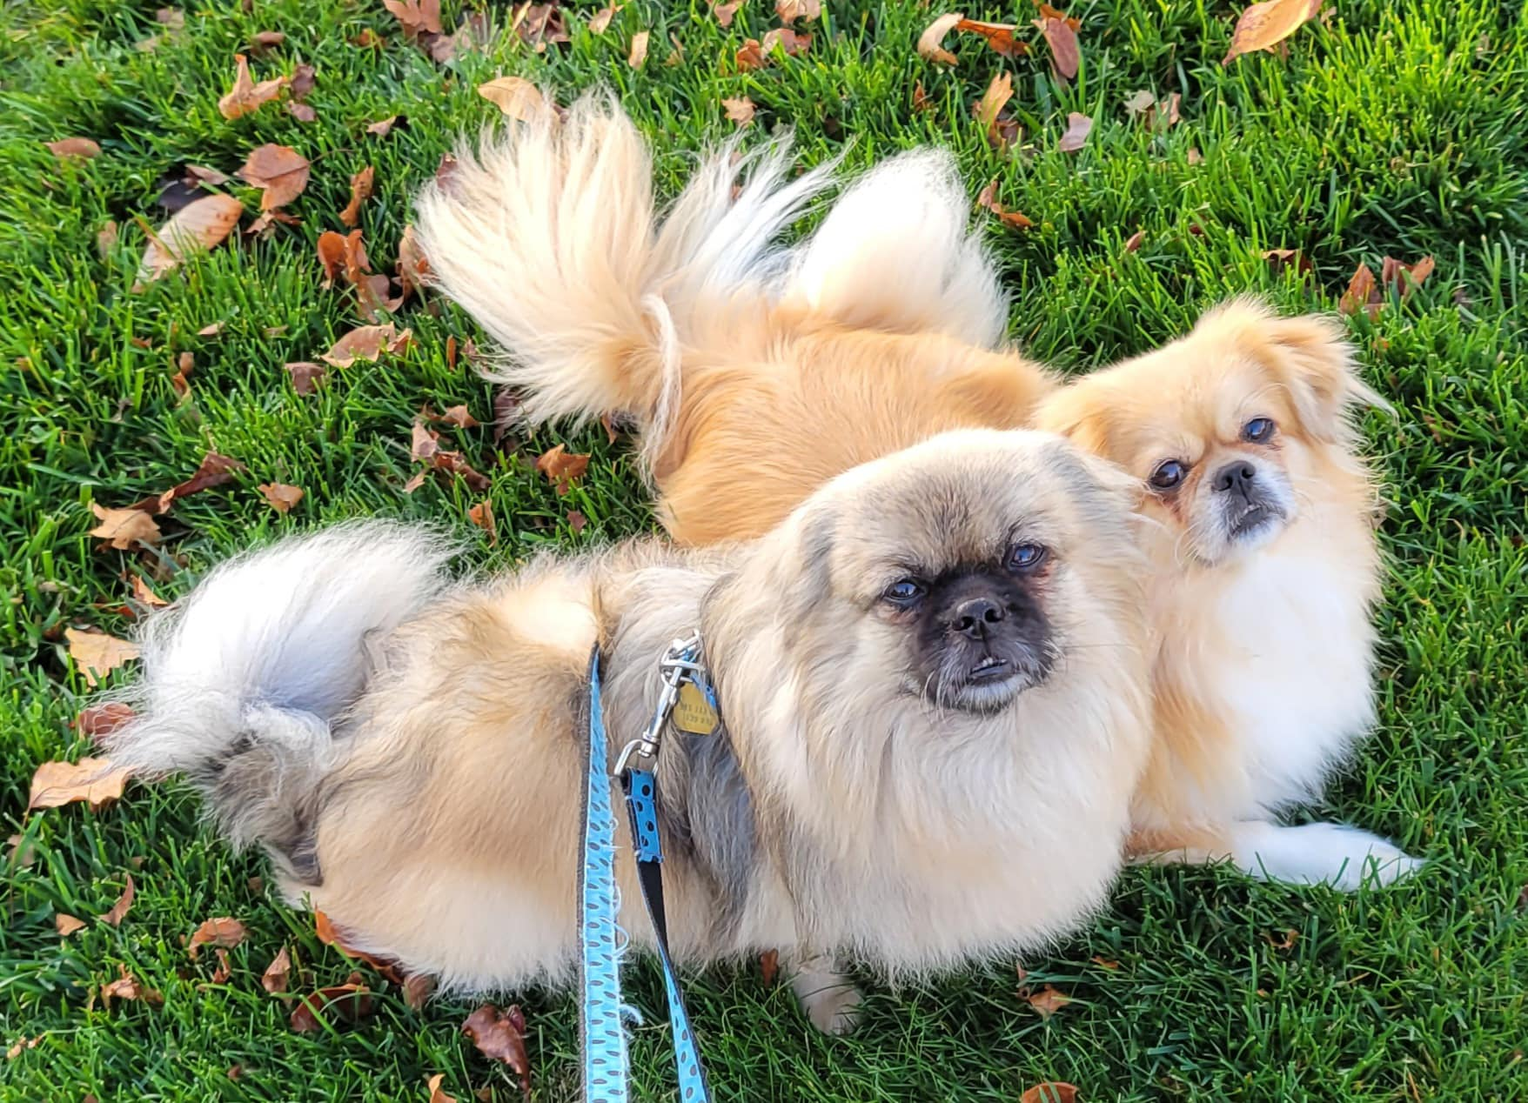
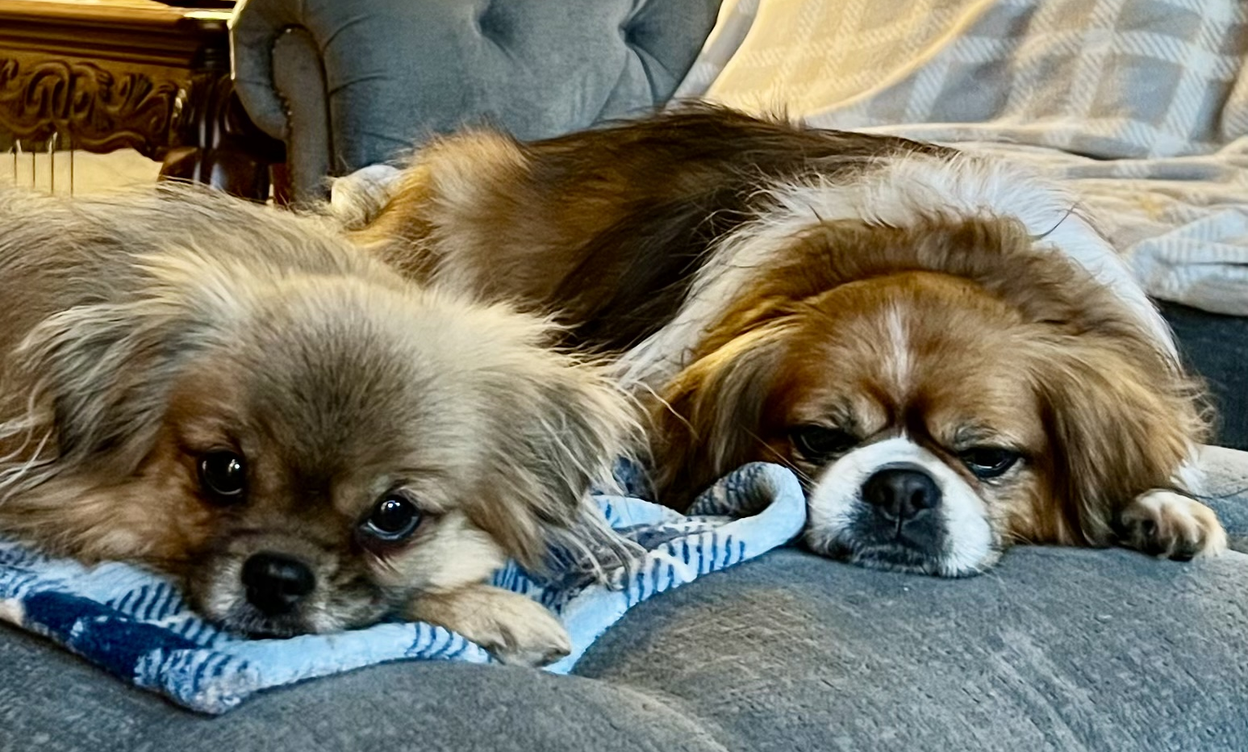
Whew! You’re all done!
Quiz Time
Please take this short quiz to reinforce the “big concepts” we’ve introduced. Here’s the link:
Quiz – 30,000 Foot Overview
Toby (top, left) was surrendered in New York and placed with a foster-to-adopt family in Connecticut. Here he is with his Tibbie sister, Sky.
Tori (bottom, left) was surrendered in New York and placed with a foster-to-adopt family in Georgia. Here she is with Tibbie brother, Mo, who was also adopted from TSCA Rescue.
What’s Next?
The Training Coordinator, National Coordinator, National Advisor will guide you in completing lessons on the role you’ve volunteered for.

